Slide 1
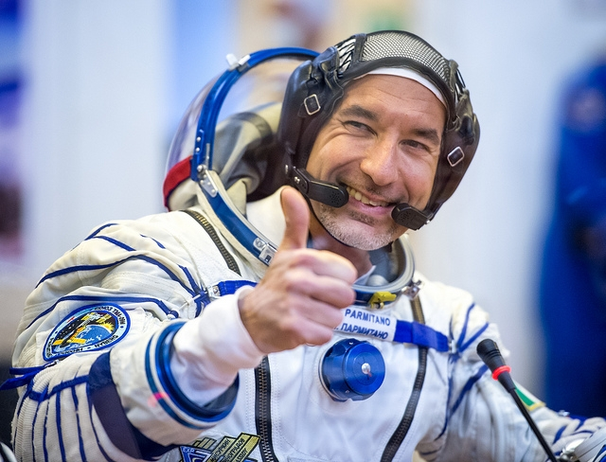
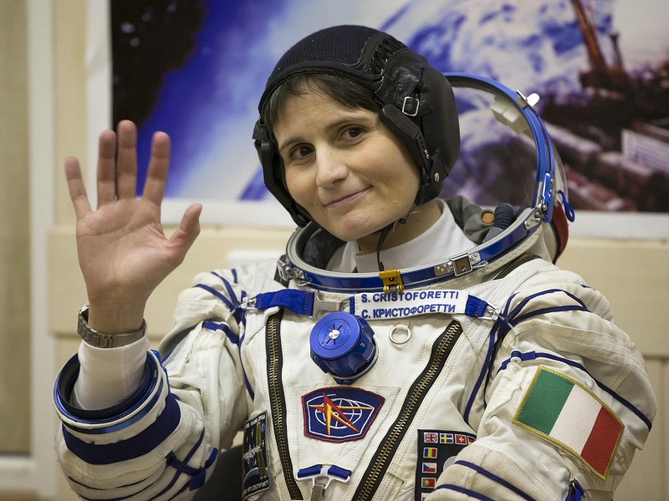
Our astronomers
Luca Parmitano and Samantha Cristoforetti

Slide 2
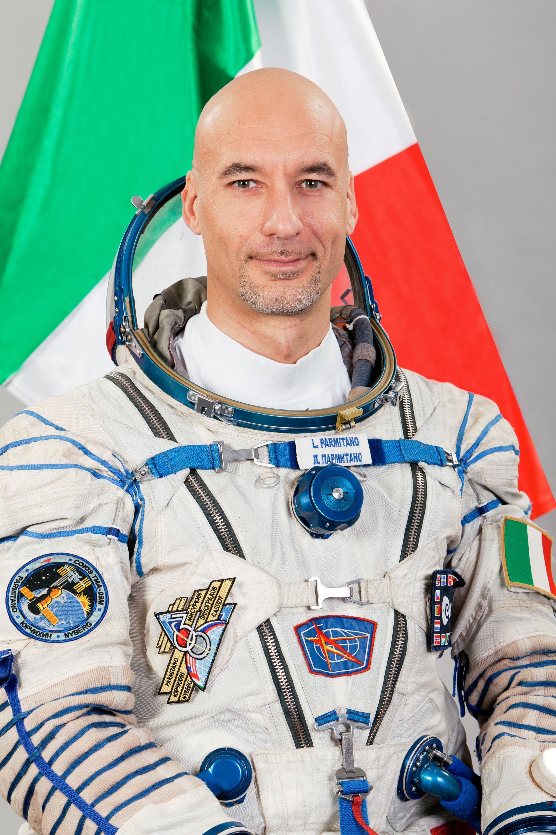
Who is Luca Parmitano?
Luca Parmitano is an italian astronaut.
He was born in Sicily.
He was the first Italian (third European) captain of the ISS.
He has been in space for 366 days, 23 hours, and 30 minutes.

Slide 3
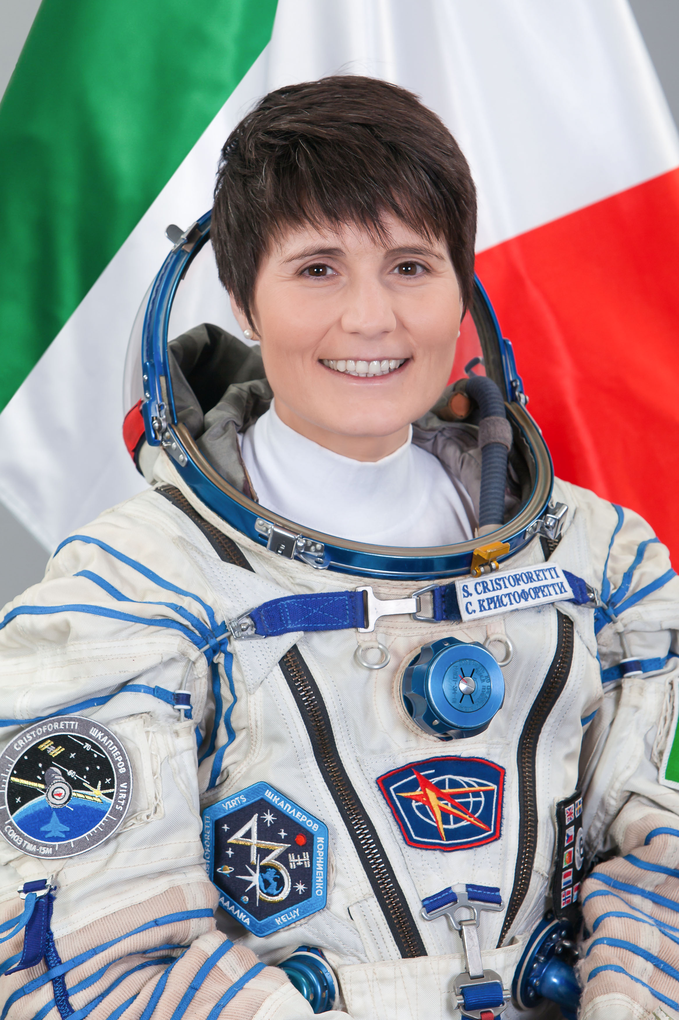
Who is Samantha Cristoforetti?
Samantha Cristoforetti is an Italian astronaut.
She was born in Milan, but she grew up in Trentino (Malè).
She was the first Italian and European woman, captain of the ISS.
She has been in space for 369 days.
She can speak: Italian, English, German, French, Russian and she is currently studying chinese!

Slide 4
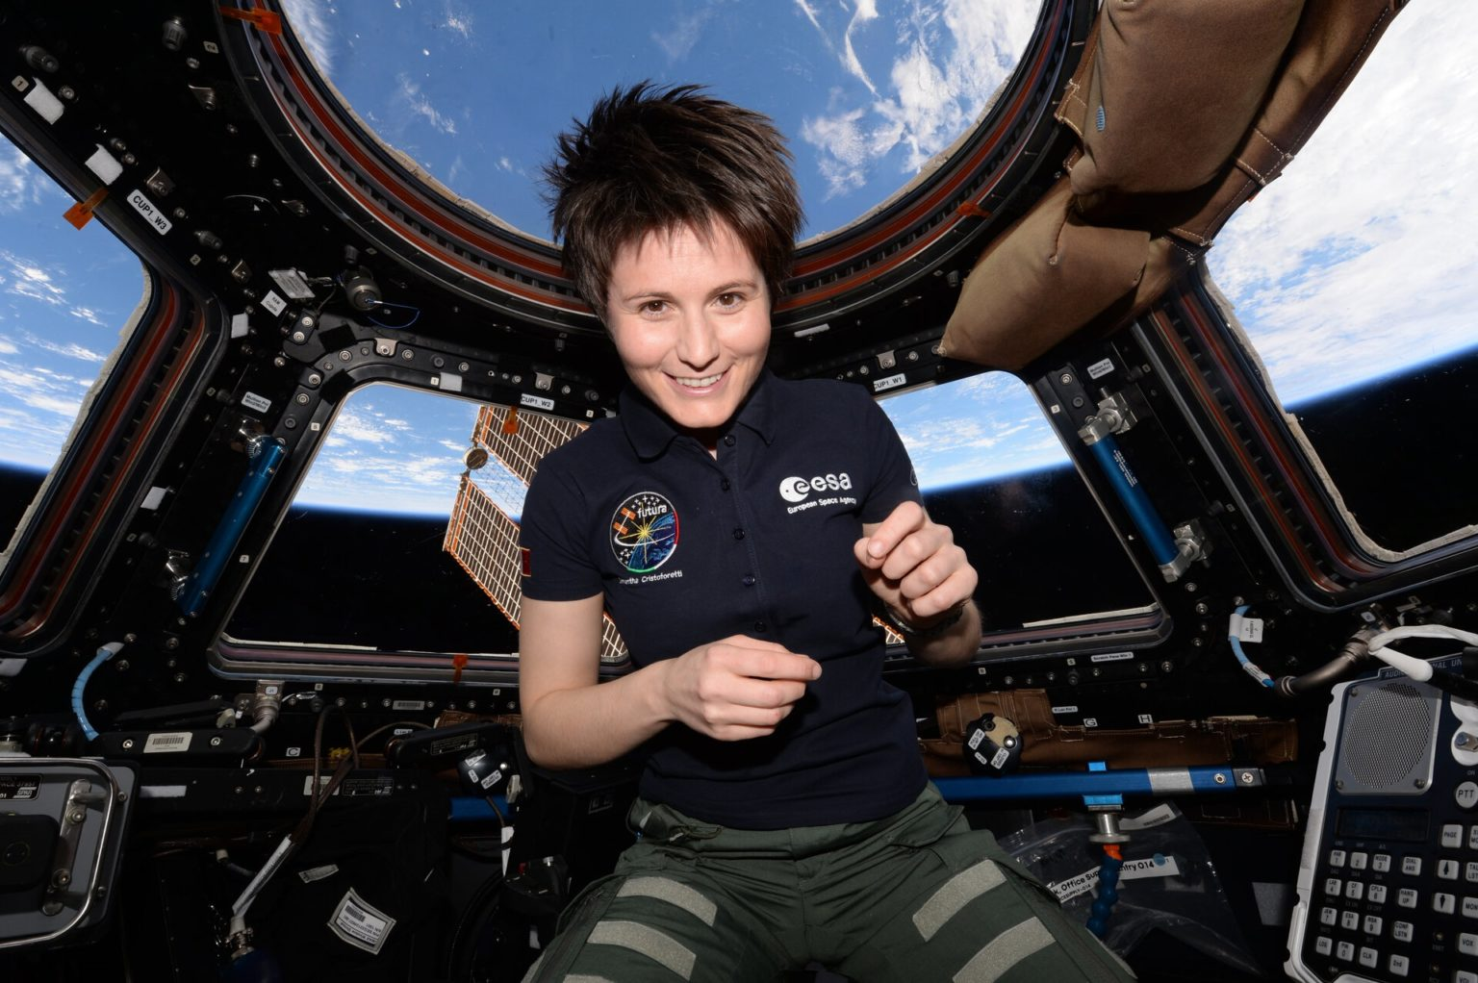

Slide 5
